Slide 1
Wireless World Wide Web:
Mobile Access to Web Resources
王讚彬
台中教育大學資訊系

Slide 2
Outline
Mobile Access to Web Resources
Wireless Computational Models
Caching and Prefetching
Disconnected Operation
Conclusions

Slide 3
World Wide Web
Developed by Tim Berners-Lee in 1991 at the European Particle Physics Laboratory (CERN) to allow physicists around the world to share information
Based on the concept of hypertext
Single interface to a variety of protocols and standards to access the information on the Internet
Has become the predominant Internet application

Slide 4
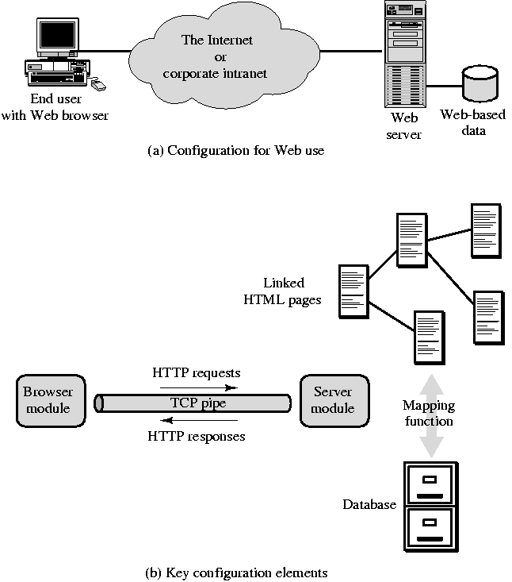
Web-Based
Applications
HTML (HyperText Markup Language)
HTTP (HyperText Transfer Protocol)

Slide 5
Wireless Characteristics
High Cost
  The cost per byte transmitted is orders of magnitude greater than traditional wireline (LAN/WAN) network
High Latency
  The response time for wireless links in WANs is much slower than their wireline or wireless LAN counterparts
Low Bandwidth
  The capacity of WAN wireless links is limited compared to most wireline links
Low Reliability
  Wireless WAN connections are significantly less reliable than wireline

Slide 6
Bandwidth Gap and Resource Gap
While the absolute performance measures of mobile systems will undoubtedly improve, what we call bandwidth gap and resource gap will remain.

Slide 7
Technical Standards
Mobile interest group within the World Wide Web Consortium( W3C) http://www.w3c.org/Mobile
Wireless Application Protocol (WAP) Forum http://www.wapforum.org

Slide 8
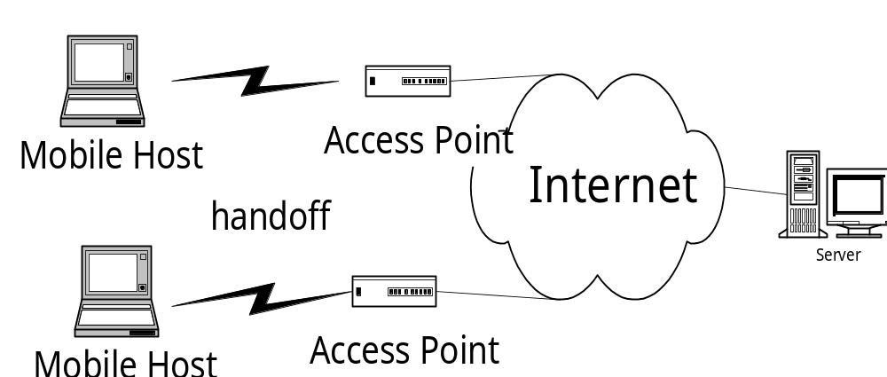
Requirement and Assumption
Has Mobile TCP/IP support

Slide 9
Wireless Computation Models
Client/Server
Client/Proxy/Server [7]
Client/Intercept/Server (Client/Intercept) [3,4]

Slide 10
Client/Server Model
wireless
link
Application
Server
Client
Mobile Host
•Weakness: inefficiency

Slide 11
Client/Proxy/Server Model
wireless
link
Application
Server
Client
Proxy
(intelligent filter)
Mobile Host
•Advantage: alleviate the impact of last link problem via proxy filter
•Weakness: optimizes only data transmission over the wireless link from the proxy to mobile client.

Slide 12
Client/Intercept Model
Web Browser
Web Server
HTTP
(TCP/IP)
HTTP
(TCP/IP)
Client Side Intercept (CSI)
TCP/IP
Server Side Intercept (SSI)
•Advantage: no changes to client and server codes
• Weakness: requires development work

Slide 13
Optimization methods
Prefecthing
Caching
Differencing
Protocol reduction
Header reduction

Slide 14
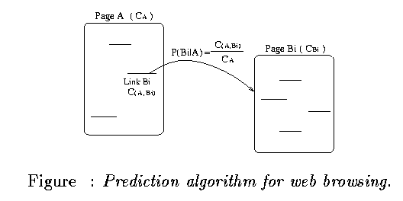
Web Prefetching [5]
Find out the likelihood
Compute a prefetch threshold

Slide 15
Caching [3,4]
The cache methods are designed for browsing of store documents or files that changes relatively infrequently
  Cross-session persistence of cached objects is critical for wireless users
  Caching user data to capture the user’s temporal and query history
  allow users to declare frequently accessed or critical information
Cache coherency model
  when a cached object is referenced,
    CSI checks to see if coherency interval has been exceed
    SSI verify that object in question has not changed via cyclic redundancy check

Slide 16
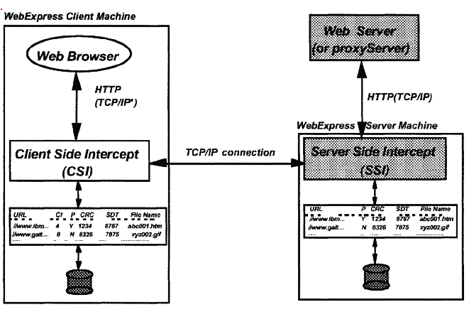
Caching

Slide 17
Differencing [3,4]
Designed for CGI processing, e.g., a stock-quote server.
  Different replies from the same program are usually very similar
Base objects are maintained at both CSI and SSI.
SSI uses a digital signature (checksum) to check if the base object are the same
SSI send a differencing stream which consists of a sequence of copy and insert commands to CSI

Slide 18
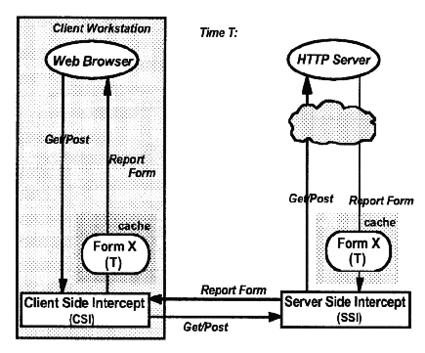
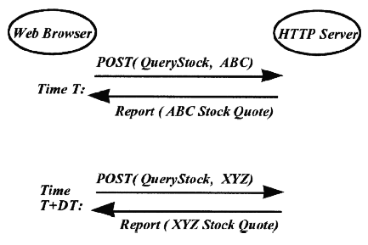
Differencing

Slide 19
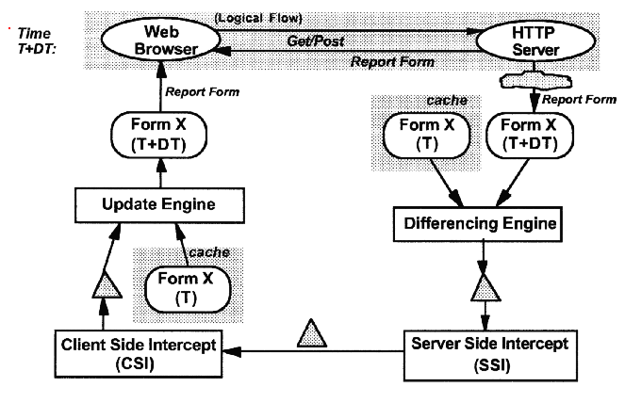
Differencing

Slide 20
Protocol and Header Reduction
Reduction of TCP/IP connection overhead
Reduction of HTTP headers

Slide 21
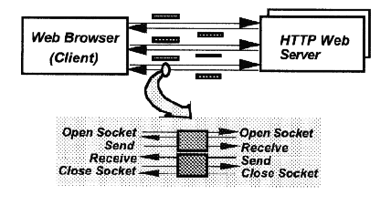
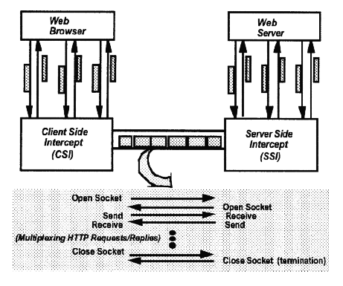
Protocol reduction

Slide 22
Disconnected Operation
Queue all requests while disconnected, process the queued requests after network re-connection
Support disconnected update via the HTTP proxy model
  Staging changes in the local writeable caches until the network become available
  Propagating changes to servers

Slide 23
Conclusions
Mobile access to information is an important technical area.
There are lots of hard problems to be solved.
This presentation describes interesting initial solutions to these problems.

Slide 24
References
[1] J.F. Bartlett. “W4-the Wireless World Wide Web,” Proc. Wksp. Mobile Computing System and Applications, Santa Cruz., CA, Dec., 1994, pp.176-178.
[2] T. Berners-Lee et al. “The World Wide Web,” Communications of ACM, 37(8):76-82, 1994.
[3] R. Floyd, B. Housel, and C. Tait, "Mobile Web Access Using Network Web Express," IEEE Personal Communications, Vol. 5, No. 5, pp. 47-52, October 1998
[4] B.C.Housel, G.Samaras, and D.B.Lindquist, “WebExpress: A Clinet/Intercept Based System for Optimization Web Browsering in a Wireless Environment,” ACM Mobile Networks and Applications, Vol.3, pp.419-431, 1998.
[5] Z. Jiang and L. Kleinrock, "Web Prefetching in a Mobile Environment," IEEE Personal Communications, Vol. 5, No. 5, pp. 25-34, October 1998
[6] M.S. Mazer and C.L. Brooks, "Writing the Web While Disconnected," IEEE Personal Communications, Vol. 5, No. 5, pp. 35-41, October 1998
[7] B. Zenel and D. Duchamp, “A General Purpose Proxy Filtering Mechanism Applied to the Mobile Environment,” Proceedings of ACM MOBICOM 97, Budapest Hungary, pp248-259.

